Slide 1
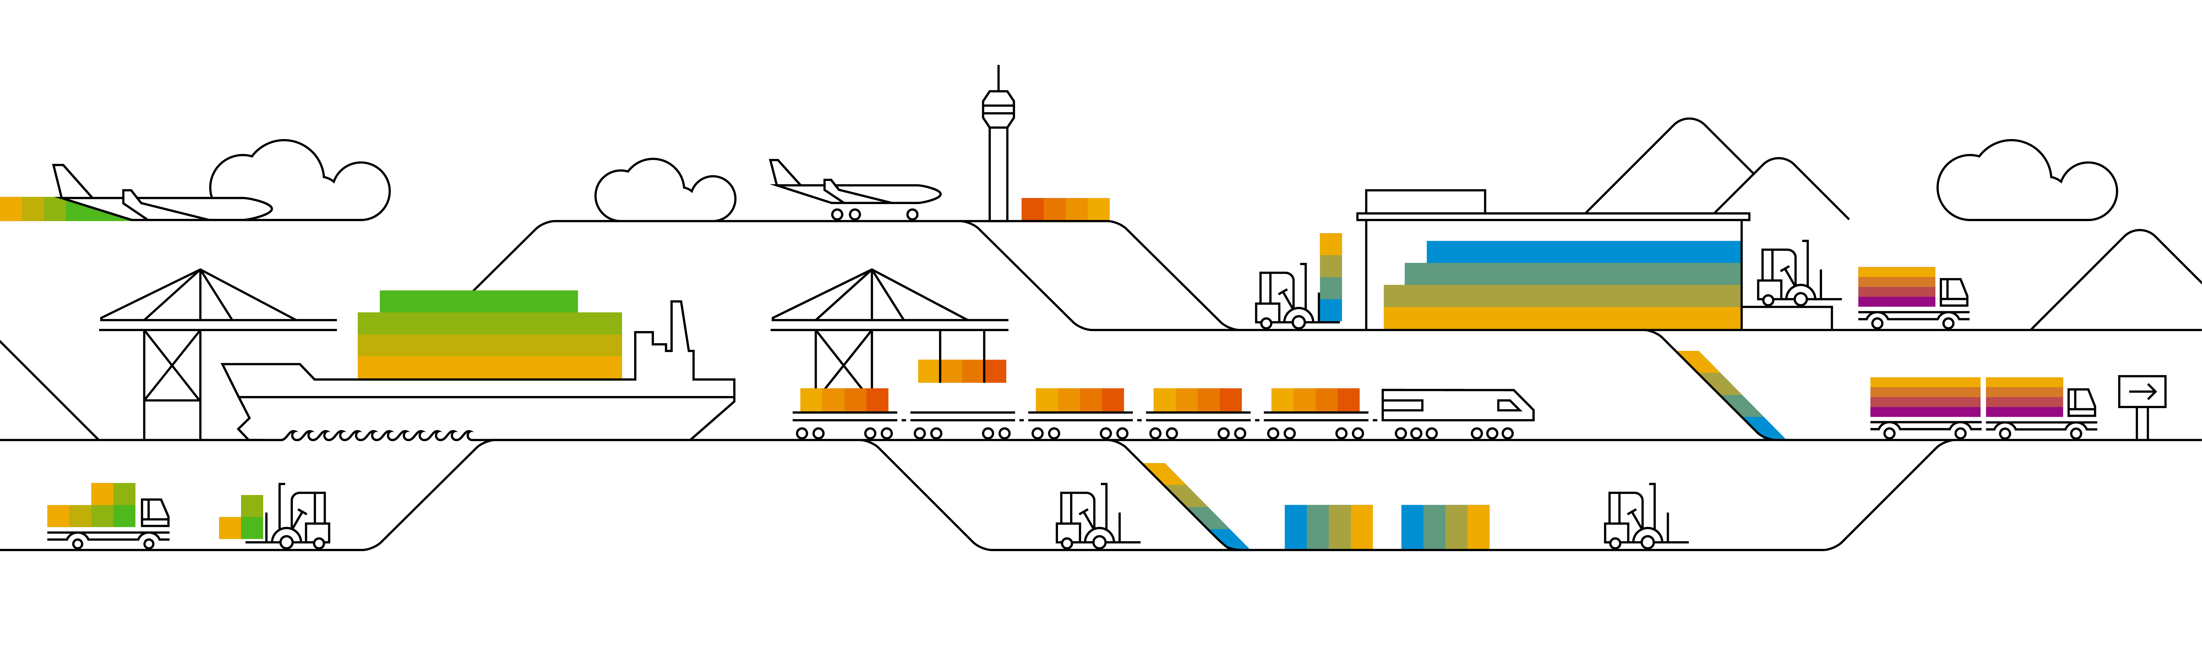
Supplier Info Pack
Standard Account
Rev. 07/20/2017

Slide 2






Learn About Ariba Network, standard account
Topics
Overview
Next Steps
What is a standard account?
What do I do next?
How does a standard account benefit me?
Benefits
Upgrade
Help
Can I upgrade my standard account?
Where do I go for help?
FAQ
FAQ

Slide 3

Overview standard account
Topics
Overview
Next Steps
Benefits
Upgrade
Help
FAQ

Slide 4

Introduction to Ariba Network, standard account
Topics
Your customer is pleased to announce a new initiative to streamline their procurement and accounts payable processes. By partnering with SAP Ariba® and implementing Ariba Network, light account via interactive email, this initiative indicates a shift to paperless and automated business transactions. Since 1996, Ariba has been transforming the global procurement landscape for businesses of all sizes, and we are excited to provide you with this opportunity.
What is standard account?
Standard account on Ariba Network gives you a fast, FREE way to do business with your customer
via interactive emails.
What does this mean for you?
Transacting on Ariba Network via a FREE standard account will allow you to meet your customer’s requirements to join them on Ariba Network with the option to avoid fees.
What are the benefits?
Standard account provides access to quickly transact with SAP Ariba customers for FREE,
improve customer retention, and get paid faster.
Overview
Next Steps
Benefits
Upgrade
Help
FAQ

Slide 5
Next steps
Topics
Overview
Next Steps
Benefits
Upgrade
Help
FAQ

Slide 6
Next Steps
Topics
Overview
Receive interactive email from your customer
Sign up for standard account
Configure account, accept terms of use, and register
Transact with customer using standard account
Next Steps
Benefits
Show me how
Show me how
Show me how
Show me how
Upgrade
Help
FAQ

Slide 7
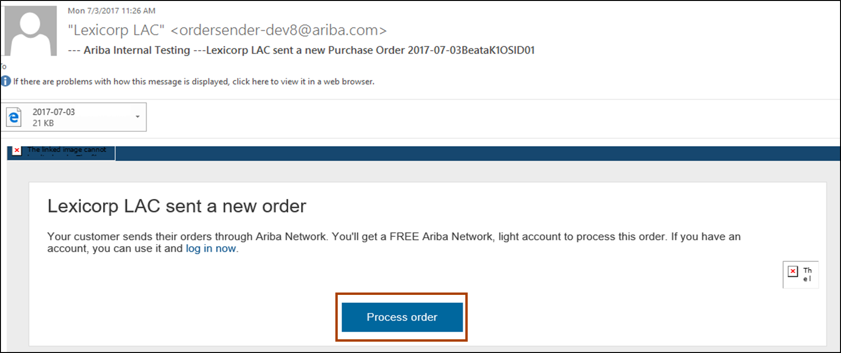
Receive Interactive Email Order from Customer
Topics
Click the Process Order button in the PO notification (interactive email)
Overview
Next Steps
Benefits
Upgrade
Help
FAQ
Next step

Slide 8
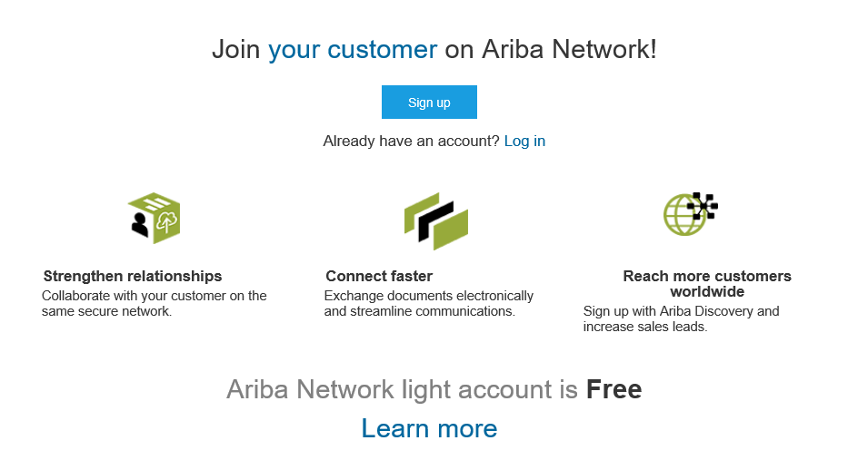
Sign Up for standard account
Topics
Select the Sign up option to create a new standard account
-OR- use your existing standard account by clicking on Log in
Overview
Next Steps
Benefits
Upgrade
Help
FAQ
Next step

Slide 9
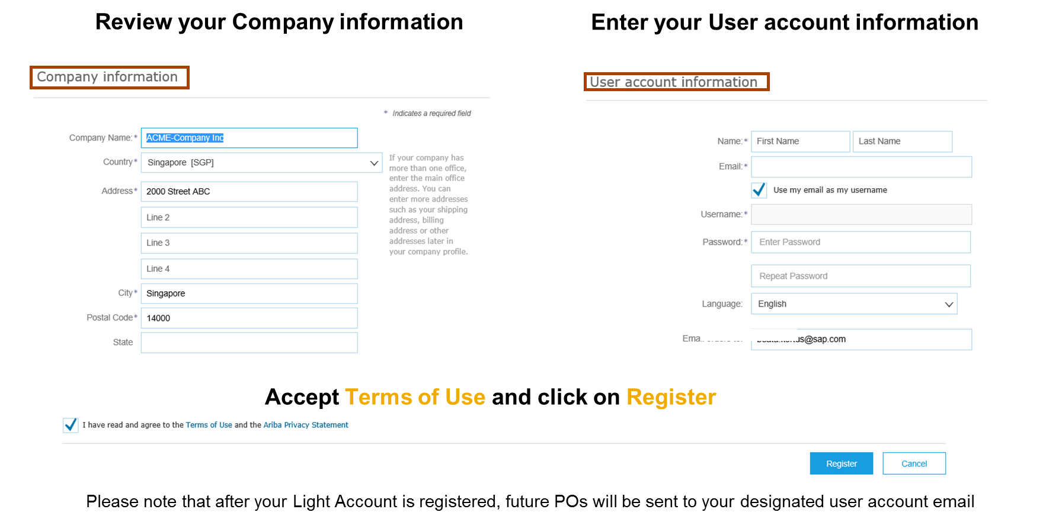
Configure Account, Accept Terms of Use, and Register
Topics
1
2
Overview
Next Steps
Benefits
Upgrade
3
Help
FAQ
Next step

Slide 10
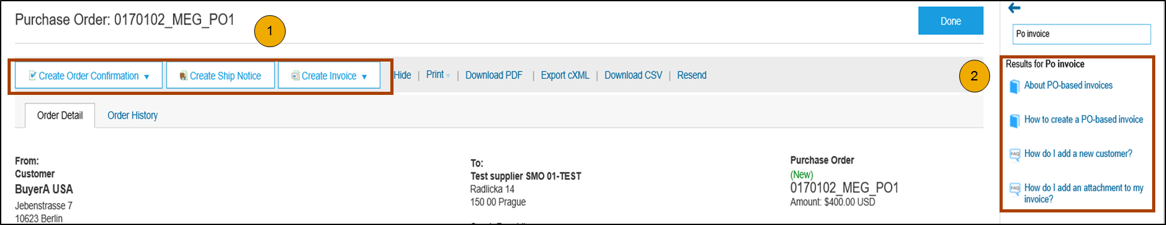
Transact with customer using standard account
Topics
Click on Create Order Confirmation, Create Ship Notice, or Create Invoice to get started.
1
Overview
2
If you need assistance, please refer to the articles in the Help Center (right-hand side).
Next Steps
Benefits
Upgrade
Help
FAQ
Next step

Slide 11
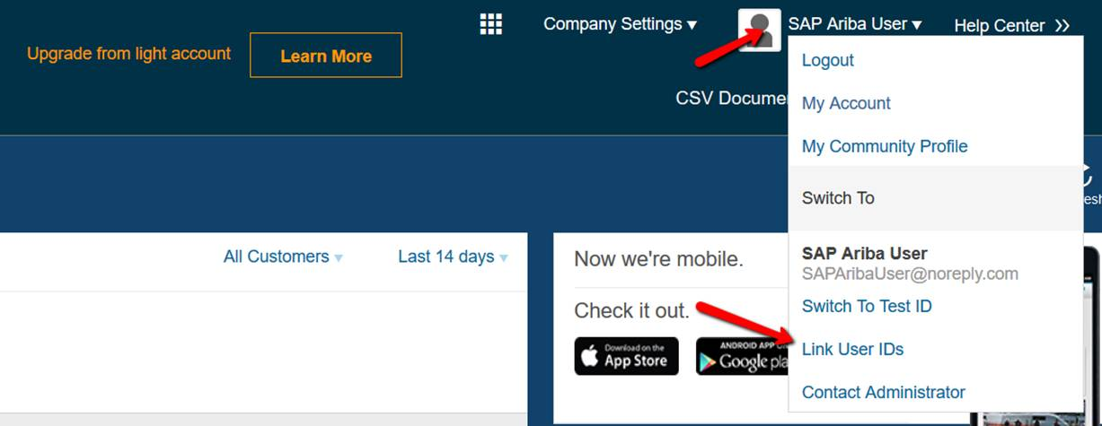
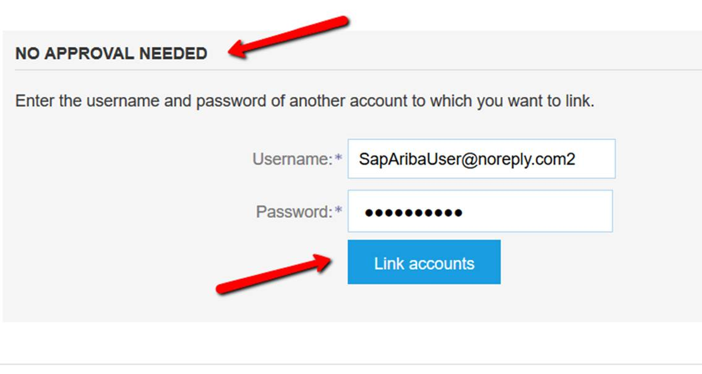
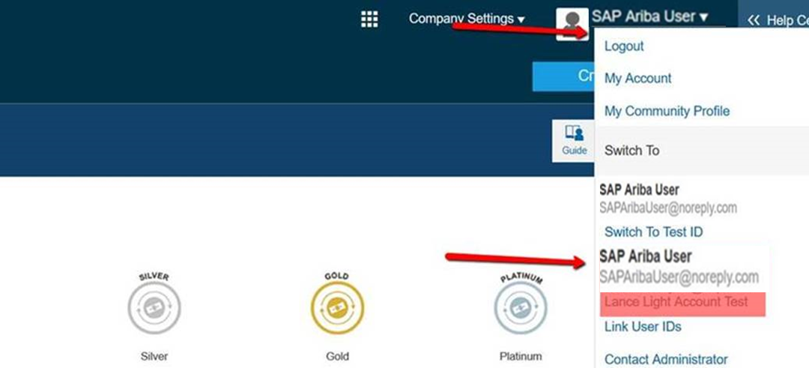
Optional- Link Standard Account & Enterprise Account User IDs
Topics
1
From your standard account dashboard, click your name to the right of Company Settings and click on Link User IDs from the menu.
Once a User ID is linked it cannot be unlinked
Overview
Next Steps
Under No Approval Needed enter the credentials for the enterprise account to be linked and click Link Accounts
Benefits
2
3
You can then switch between the linked User IDs by clicking your name and the account you would like to access
Upgrade
Help
FAQ

Slide 12
Benefits
Topics
Overview
Next Steps
Benefits
Upgrade
Help
FAQ

Slide 13
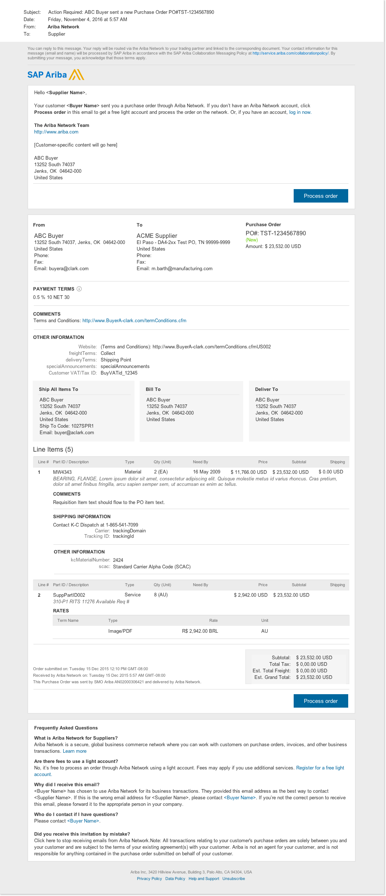

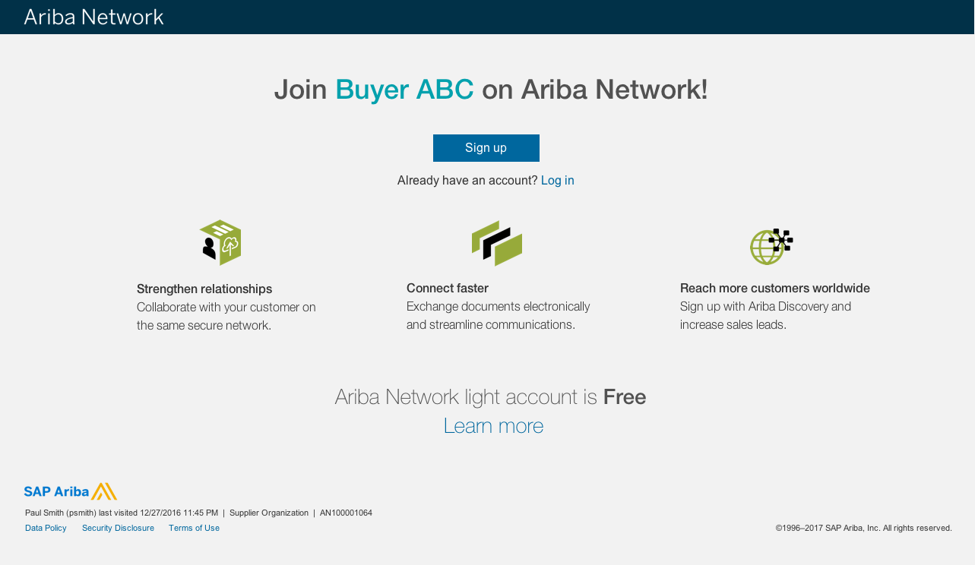
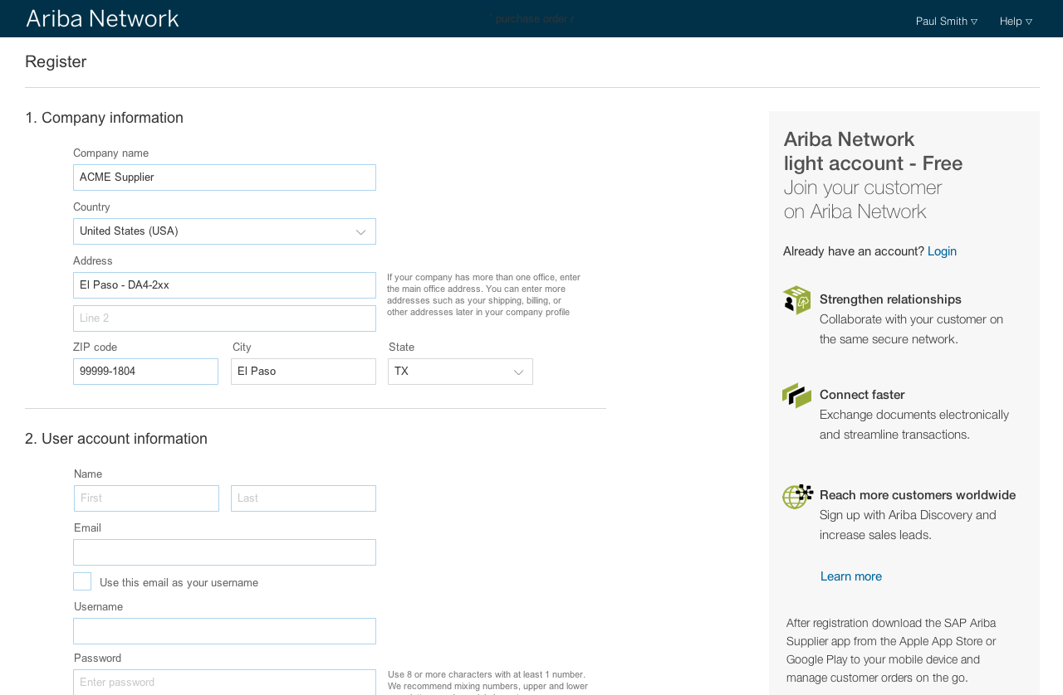
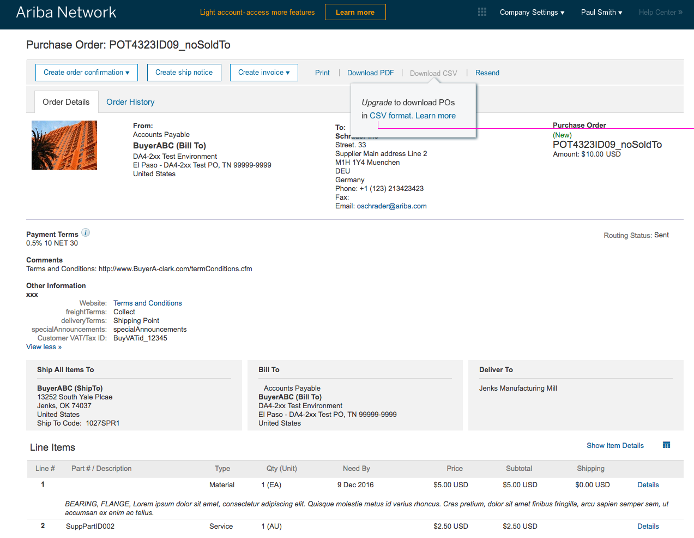
How standard account benefits YOU
Topics
FREE for all basic transactions
Create validated, electronic invoices and other business documents within seconds
Improve invoice accuracy and get paid faster
Receive real-time invoice status notifications
Increase business with existing and future customers using Ariba Discovery
Promote your company to other customers on Ariba Network
Email notification and online download provide access to invoices for your local archiving
Enjoy a single, unified user experience using one account for order fulfillment, selling, and mobile access
Overview
Next Steps
Benefits
Upgrade
Help
FAQ

Slide 14
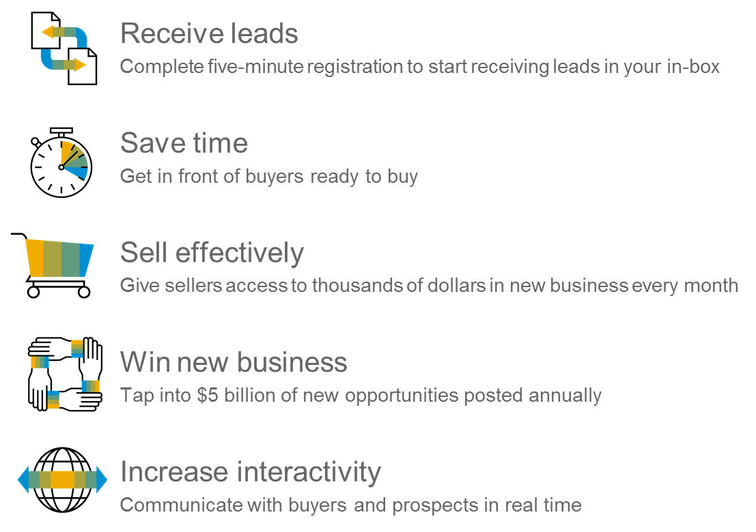
Topics
Ariba Discovery
Matching Suppliers to Buyers Ready to Buy
Overview
Next Steps
Benefits
Upgrade
Help
FAQ

Slide 15
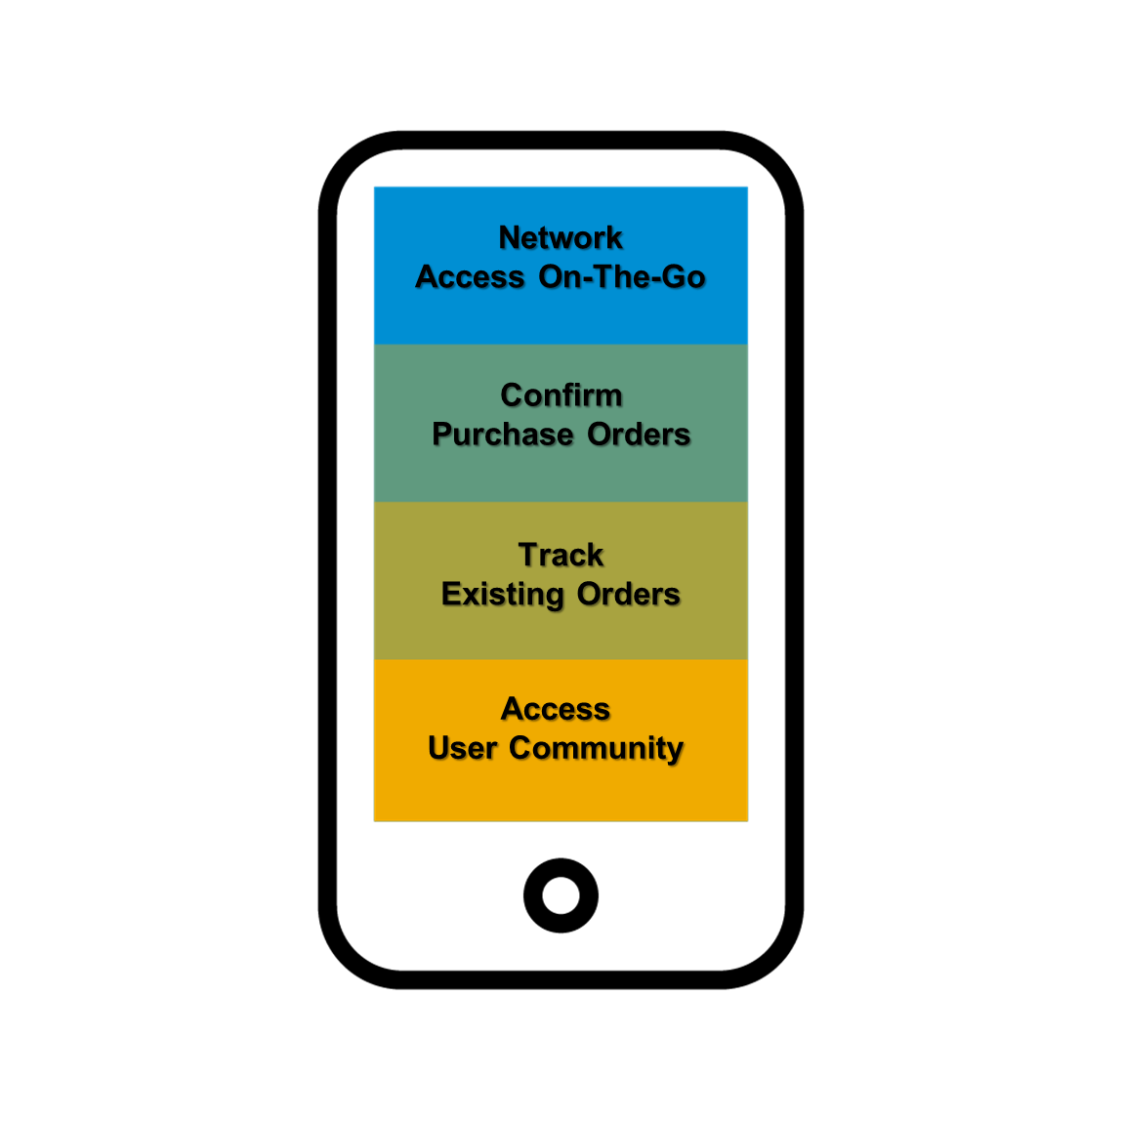
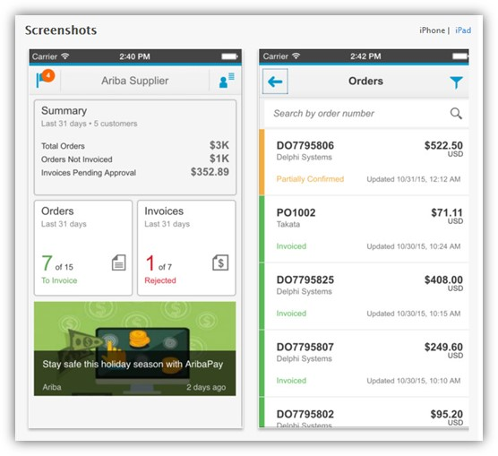
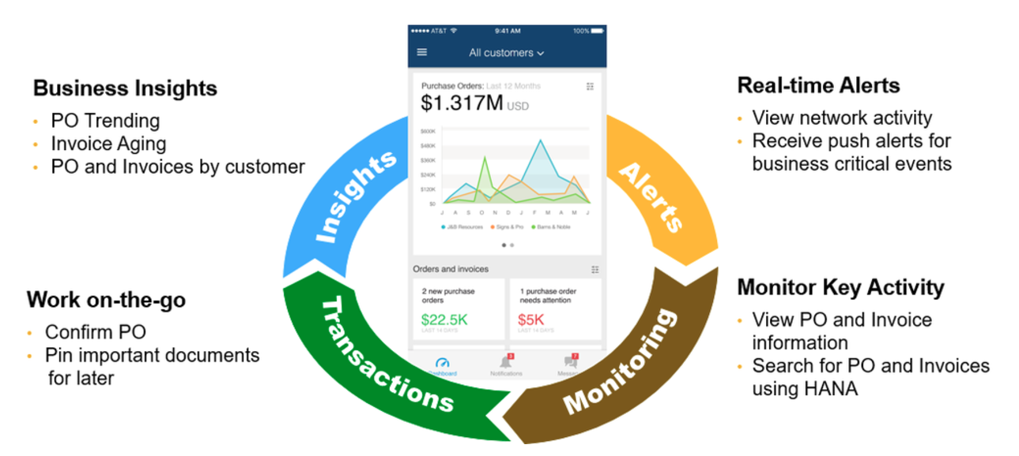
Topics
Topics
SAP Ariba Supplier Mobile App
Overview
Overview
Next Steps
Next Steps
Benefits
Benefits
Upgrade
Upgrade
Help
Help
FAQ
FAQ
Apple iTunes App Store or Google Play

Slide 16
Upgrade
Topics
Overview
Next Steps
Benefits
Upgrade
Help
FAQ

Slide 17
Standard Account vs. Enterprise Account on Ariba Network
Topics
Features | Light Account | Full-use Account
Access | Through email notifications | Online dashboard
Company Profile |  | 
Purchase Order, Order confirmation (full & partial), Ship Notice, Service Entry Sheet, (Non-PO) Invoice, Credit Memo |  | 
Electronic Catalogs |  | 
Invoice status | Email notifications | Outbox with easy access from any browser
Legal Archive | Email notification and online download | Long-term invoice archiving for global compliance (Regional restrictions apply) Capability to mass download invoices for local archiving
Ariba Support | Online Help Center | Support via phone, chat, or email Direct access to enablement experts for onboarding assistance Technical support for configuration and integration assistance Online educational training courses
Integration |  | 
Reporting |  | 
Multiple customer relationships |  | 
Multi users |  | 
Mobile App |  | 
Ariba Discovery |  Fees may apply to respond to leads. Click here for more information. |  Fees may apply to respond to leads. Click here for more information.
Fees | FREE | Fees may apply, See complete details.
Overview
Next Steps
Benefits
Upgrade
Help
FAQ
More

Slide 18
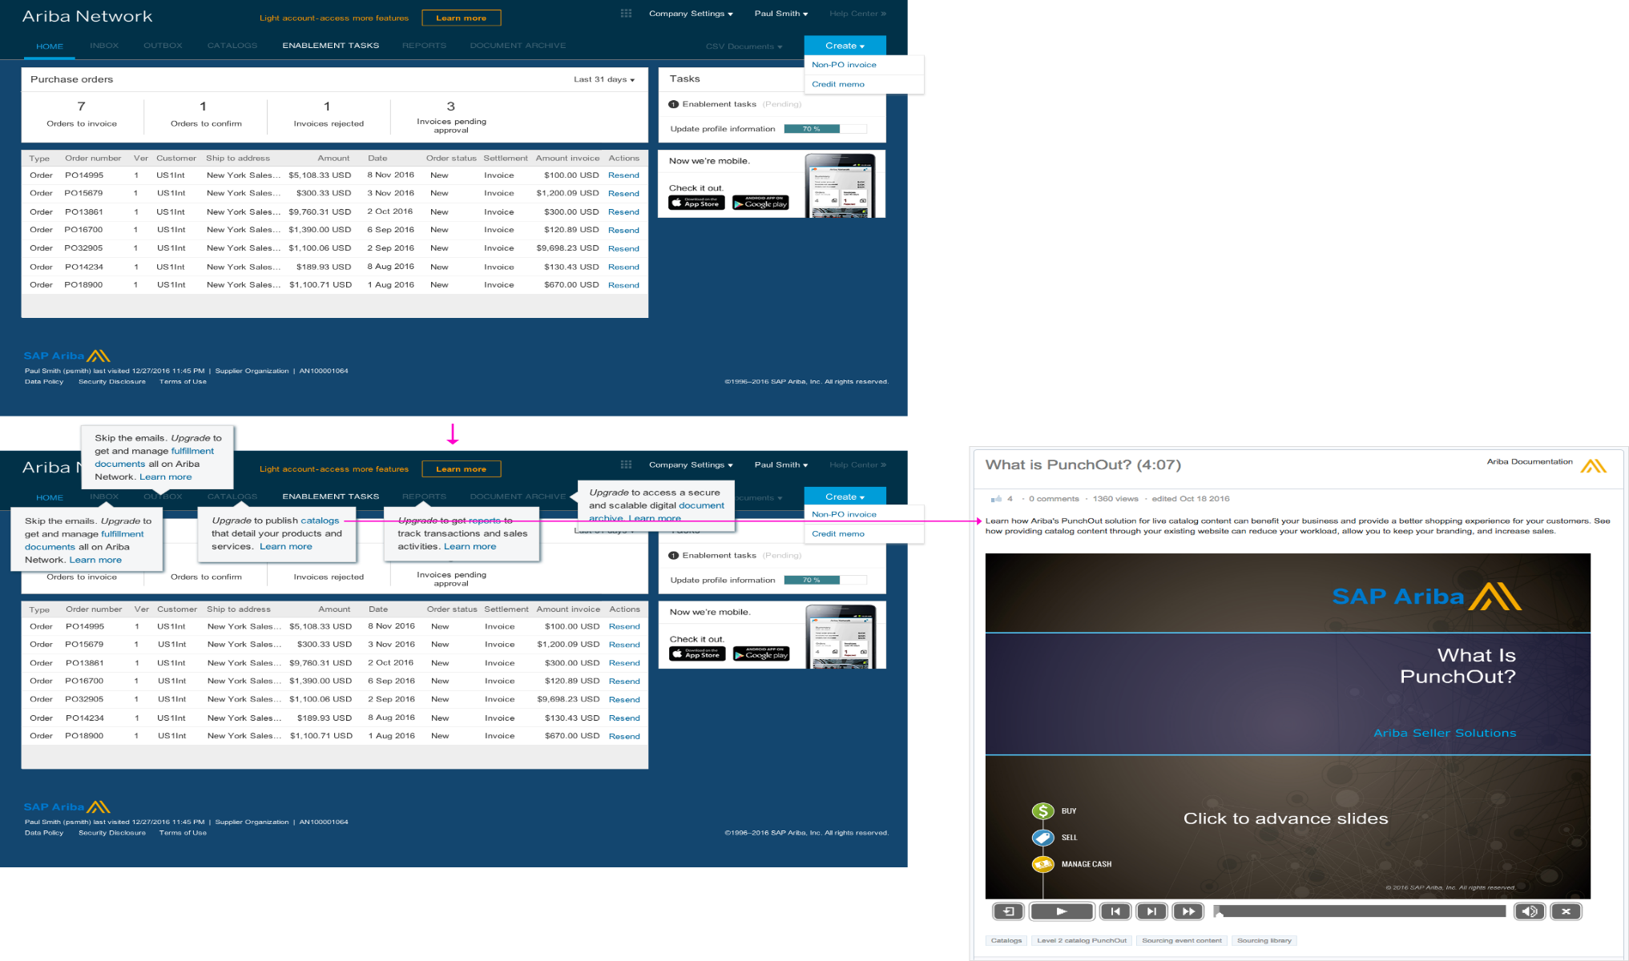
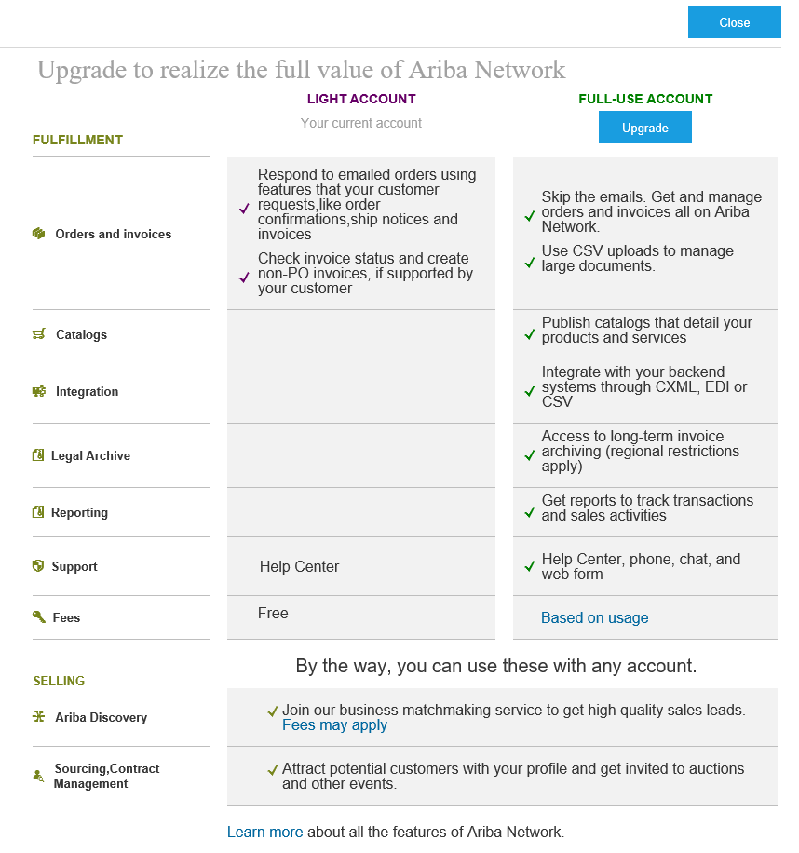
Home Page – Upgrade to Realize the Full Value of Ariba Network
Topics
Overview
Upgrade
Next Steps
Benefits
Upgrade
Help
FAQ

Slide 19
Help
Topics
Overview
Next Steps
Benefits
Upgrade
Help
FAQ

Slide 20


Supplier Help Resources
Topics
The Help Center will provide assistance while using your standard account:
Click the Help Center link at the bottom of your interactive email
When logged into your light account, click the Help Center link in the upper right corner to expand the panel and gain access to relevant help topics
The Ariba Network, standard account support page will provide access to:
A summary of standard account features
A quick tutorial on how to replay and respond to your customer
Side-by-side comparison of standard account and enterprise account
The Supplier Success Session Portal to register for an upcoming live demo
A pre-recorded overview and demo of standard account
Overview
Next Steps
Benefits
Upgrade
Help
FAQ

Slide 21
FAQ
Topics
Overview
Next Steps
Benefits
Upgrade
Help
FAQ

Slide 22
FAQ
Topics
Q: What is Standard Account capability on Ariba Network?
A: Ariba Network, standard account capability is a new, fast, free way to automate business with any buyer. Support for most transaction types helps
maximize efficiency and meet buyer compliance requirements. There is no need to upgrade, unless you are ready for advanced capabilities such
as support for catalogs, back-end integration or to manage larger document volumes through online access
Q: How can I access this new capability?
A: Your customer must send you a standard account invitation to transact with them using this methodology. Or if you self register on Ariba Network,
SAP Ariba Discovery or you are invited to SAP Ariba Sourcing solutions and do not have or use an existing account (ANID) you can register and
will be started at the Ariba Network, light account capability level. In the latter case you will not exchange orders and invoices with your customer
unless they establish a relationship with your account first but you can use other functionality.
Q: What document types are supported for this free account?
A: Suppliers transact unlimited documents such as orders, order confirmation (OC), advance ship notices (ASN), and service entry sheets (SES),
PO-invoices using PO-Flip (convert orders into an e-invoice with the simple click of a button), non-PO invoices and credit memos, invoice status
notifications, payment proposals, and remittance details.
Q: What if I have already signed up for Ariba Network? Can I switch to Standard Account?
A: If you are already using Ariba Network with a buyer, we recommend that you continue using this transaction method. There is no direct way to
change an Ariba Network subscription (enterprise account) to a standard account.
Q: Am I required to register on Ariba Network to use Standard Account?
A: Yes. You will be sent an interactive email from your buyer. To respond you must register for a free standard account. This free account is not the
same as a enterprise Ariba Network account. You only need to upgrade to a enterprise account on Ariba Network when you determine that you desire the additional functionality.
Q: Can I access my Ariba Network Standard Account and Enterprise Account from the same user ID?
A: Yes. You can easily toggle between your standard and enterprise account by linking your user IDs.
Overview
Next Steps
Benefits
Upgrade
Help
FAQ
More FAQ

Slide 23
FAQ
Topics
Q: How do I invoice a purchase order if I lose the email notification?
A: If you misplace a purchase order (PO) email notification, you have the following options:
  Resend the PO email: Log in to your Ariba Network standard account. In the PO list on the home dashboard of your account, click
  Select > Send me a copy to take action in the Action column next to the PO.
  Request a manual copy of the PO from your customer: After you have a copy of the PO, you can create and submit a non-PO invoice.
Q: How do I create documents against purchase orders from my customer?
A: To process a purchase order, you need to click the Process Order button in the purchase order email notification.
After you register or log in to your Ariba Network standard account, you are taken to the purchase order details page, where you can
create documents like order confirmations, ship notices, and invoices against the purchase order.
Q: How do I add purchase orders to my existing Ariba Network Account?
A: If you've previously registered a l standard account or an enterprise account on Ariba Network to transact with a different customer, you
have the option to add the transactions with your new customer to your existing account.
To add your new purchase orders to your existing account:
1. In the purchase order email notification, click Process order and then click Log in on the standard account landing page.
2. Log in with the administrator username and password for the existing account.
Q: What should I do if my registration confirmation link is expired?
A: If the confirmation link expired immediately after receiving the email, please log in to your account
directly at https://supplier-2.ariba.com
If the confirmation is accepted, you will be able to view your account. If you are unable to access your account, you can request to
resend the confirmation email.
Overview
Next Steps
Benefits
Upgrade
Help
FAQ

